Slide 1
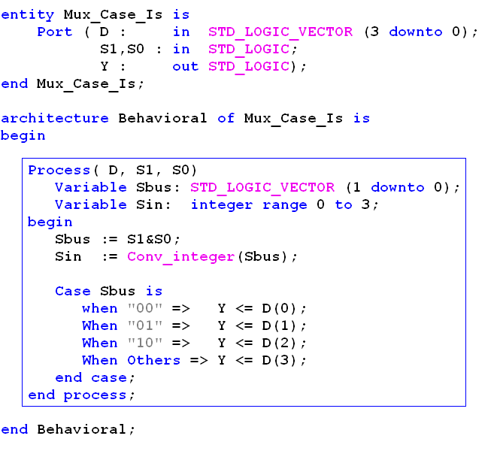
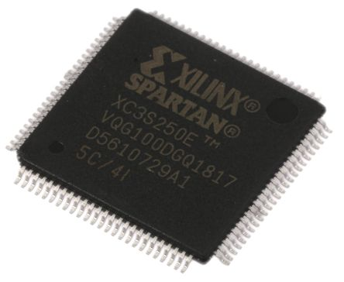

ELEC 204 Digital Design Week 1: VHDL and FPGAs
ELEC 204 Lab instructor: Mehmet Cengiz Onbaşlı
Koç University Dept. of Electrical and Electronics Engineering
Digital Design (Labs) – Week 1

Slide 2

ELEC 204 Lab Instructor: Mehmet Cengiz Onbaşlı
Assistant Prof. at Dept. of Electrical and Electronics Eng. at Koç University (Istanbul, Turkey) (2016-ongoing)
Research Scientist at Corning Incorporated (2015-2016)
Ph.D.: MIT Dept. Materials Science & Engineering, 2015
B.S.: Bilkent University, Electrical & Electronics Engineering,
Best way to contact:
Email me at
monbasli@ku.edu.tr
Research on:
magnetic materials and devices
Sensors and machine learning applications
data storage and processing technologies
epitaxial oxide thin film growth (0.7-400 nm)
photonic and optoelectronic device design & fab
High-bandwidth quantum materials and devices
Digital Design (Labs) – Week 1

Slide 3
Lab objectives
Objective: Apply combinational and sequential logic analysis and design concepts to design arbitrary logic circuit functionality in FPGA chips using VHDL.
FPGA: field-programmable gate arrays (name of the chip)
VHDL: Very High Speed Integrated Circuit Hardware Description Language (programming language)
The key skills that you are going to develop by the end of this course:
apply combinational and sequential logic analysis and design concepts to design an arbitrary digital logic circuit (see lecture materials)
understand how to design digital logic circuits using VHDL (see syntax references)
understand how to design an algorithm to carry out a desired task (algorithm examples)
debug and test VHDL code
Digital Design (Labs) – Week 1

Slide 4
Course logistics
Labs: The lab times are Friday 14:00-15:50 for Lab section A and Friday 16:00-17:50 for Lab section B. The labs are done via Zoom.
Lab Grading: 4 VHDL labs (50%) and a course project (50%)
Our TA's for the lab this semester are: Altuğ Somay <asomay@ku.edu.tr>, Arash Mousavi Cheghabouri <acheghabouri17@ku.edu.tr>, Buse Ebrem Bilgin <bebrem18@ku.edu.tr>, Rawana Yagan <ryagan18@ku.edu.tr>, Serhat Soyer <msoyer19@ku.edu.tr>.
When you have questions on the lab and the projects in the future, please email elec204-spring2021-labta-group@ku.edu.tr so that we can respond as soon as possible.
Course materials are going to be posted on ku.blackboard.com
Digital Design (Labs) – Week 1

Slide 5
Grading
We are going to ship FPGA boards to each student in the course. The students code and do a demo of their working labs to the TA’s online via Zoom and answer lab-specific questions, submit preliminary and lab reports.
The course projects are VHDL programs written by teams of students (max. 2) and submitted by the end of the semester. Students report a working project, do a demo, present demo videos and complete an oral interview.
Presenting work done by others as one’s own work is cheating and strictly forbidden. Any form of cheating is subject to KU Academic dishonesty policies: https://vpaa.ku.edu.tr/academic-policies
A working VHDL project is necessary for a passing grade.
Digital Design (Labs) – Week 1

Slide 6
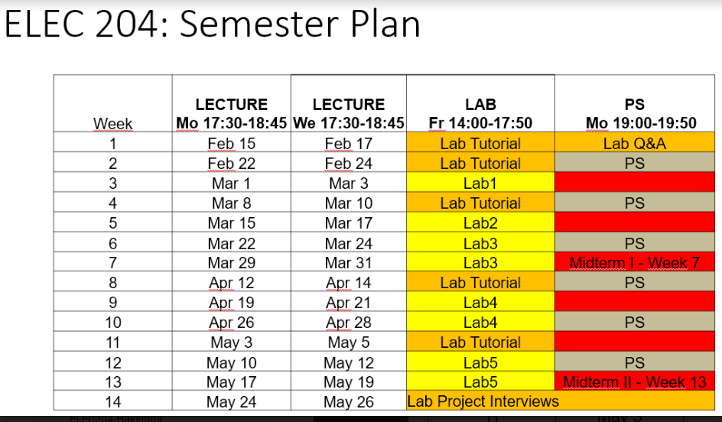
Weekly schedule
Digital Design (Labs) – Week 1

Slide 7
Necessary skills for completing ELEC 204 Labs successfully
Learn the lecture concepts very well. Thus, you can understand how to use each digital design building block and code when.
Study VHDL code examples that we will provide.
Practice writing, synthesizing and testing VHDL codes in Xilinx IDE.
Debug your code systematically by understanding the syntax and the common errors (we will provide a list). Track where each signal is assigned (or connected), if there is a missing semicolon or a missing “when others =>” expression in a case-when statement.
Make sure you google your code errors or warnings frequently since people provide example solutions for similar issues. Due to the class size, the instructor or the TA’s may not be able to immediately (or ever) solve your code problems. So you will better learn how to debug your own code.
Digital Design (Labs) – Week 1

Slide 8
ELEC 204 Lab Organization
We will ship the FPGA boards from students of the last semester.
IMPORTANT: You will install Xilinx ISE Design Suite on your computers from: https://www.xilinx.com/support/download/index.html/content/xilinx/en/downloadNav/vivado-design-tools/archive-ise.html
If you are using macbooks or other Apple computers, you will need to open a partition on your computer and install a Windows Virtual Machine and then Xilinx ISE Design Suite. Macbook users used to use the computer labs on campus to avoid having to open at least a 40-50 GB partition before the pandemic, but this step is currently necessary.
Digital Design (Labs) – Week 1

Slide 9
VHDL Introduction
Purpose:
We will study the syntax and learn how to program in VHDL.
Step 1: Install Xilinx ISE Design Suite latest version from Xilinx Web site
IMPORTANT: You will install Xilinx ISE Design Suite on your computers from: https://www.xilinx.com/support/download/index.html/content/xilinx/en/downloadNav/vivado-design-tools/archive-ise.html
Step 2: We will study the FPGA board for the labs.
Step 3: We will study VHDL language and its syntax.
Digital Design (Labs) – Week 1

Slide 10
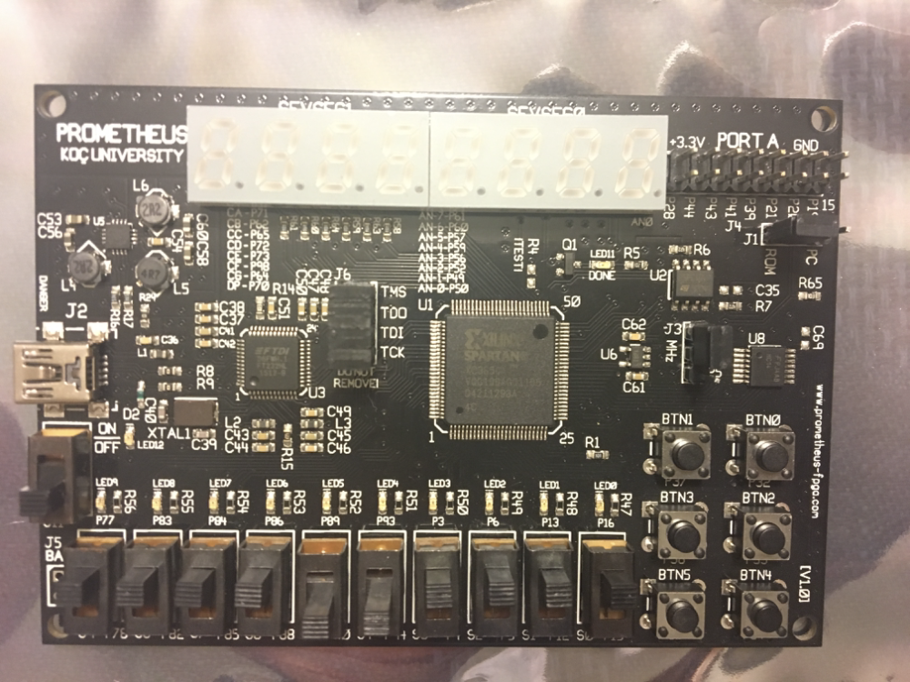
The FPGA Board
Digital Design (Labs) – Week 1

Slide 11
Course project
Pick a project partner and form teams of max. 2 people (no more than 2). Doing the projects as one student is okay.
You will propose a VHDL project on the Google drive sheet.
I will approve the project or suggest changes (if there are significant overlaps with the projects of previous years or the current semester).
By the end of the semester, you and your project partner present a working demo of your project. You will record a demo video, write and submit a report and your source code.
Digital Design (Labs) – Week 1

Slide 12
The Labs
There are 4 labs on VHDL.
I will release the lab instruction sheet at least 2 weeks before each lab.
You will do the preliminary work and submit online on Blackboard before the lab.
Then you will complete the lab at home. Upload the code on the board and demonstrate that it works.
The teaching assistants (TAs) will give 5-10 minute interviews for each of you and record your interview grade.
Finally, you will submit a lab report online on Blackboard. You lab grade will consist of the preliminary report, interview grade and the lab report.
Digital Design (Labs) – Week 1

Slide 13

VHDL Basics
ECE 448 – FPGA and ASIC Design with VHDL 1

Slide 14
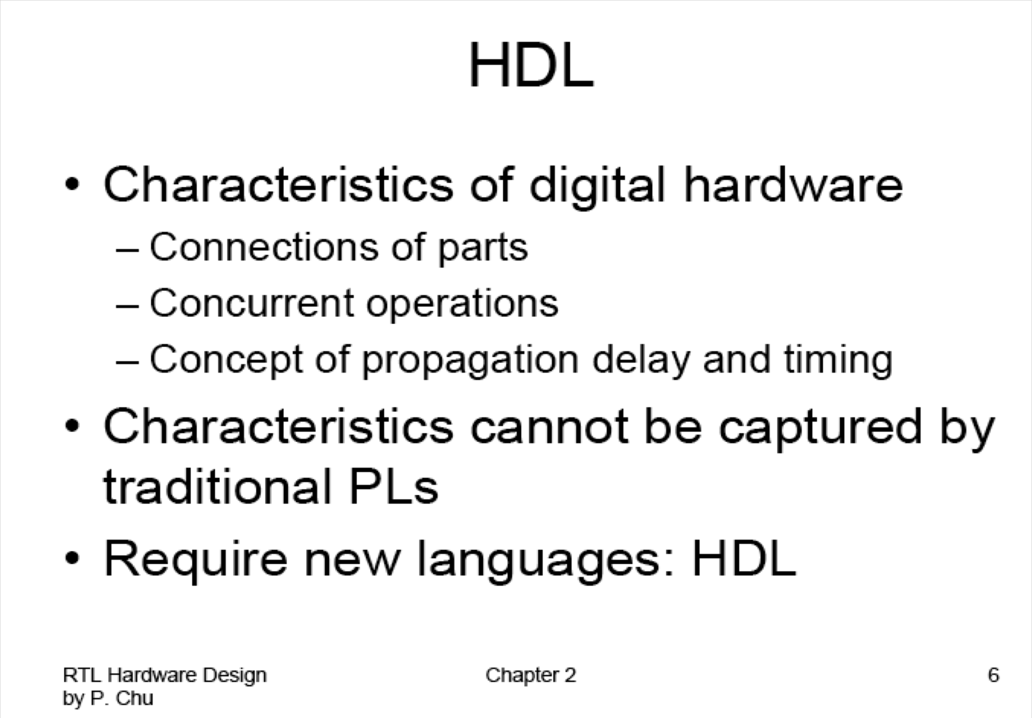

Slide 15
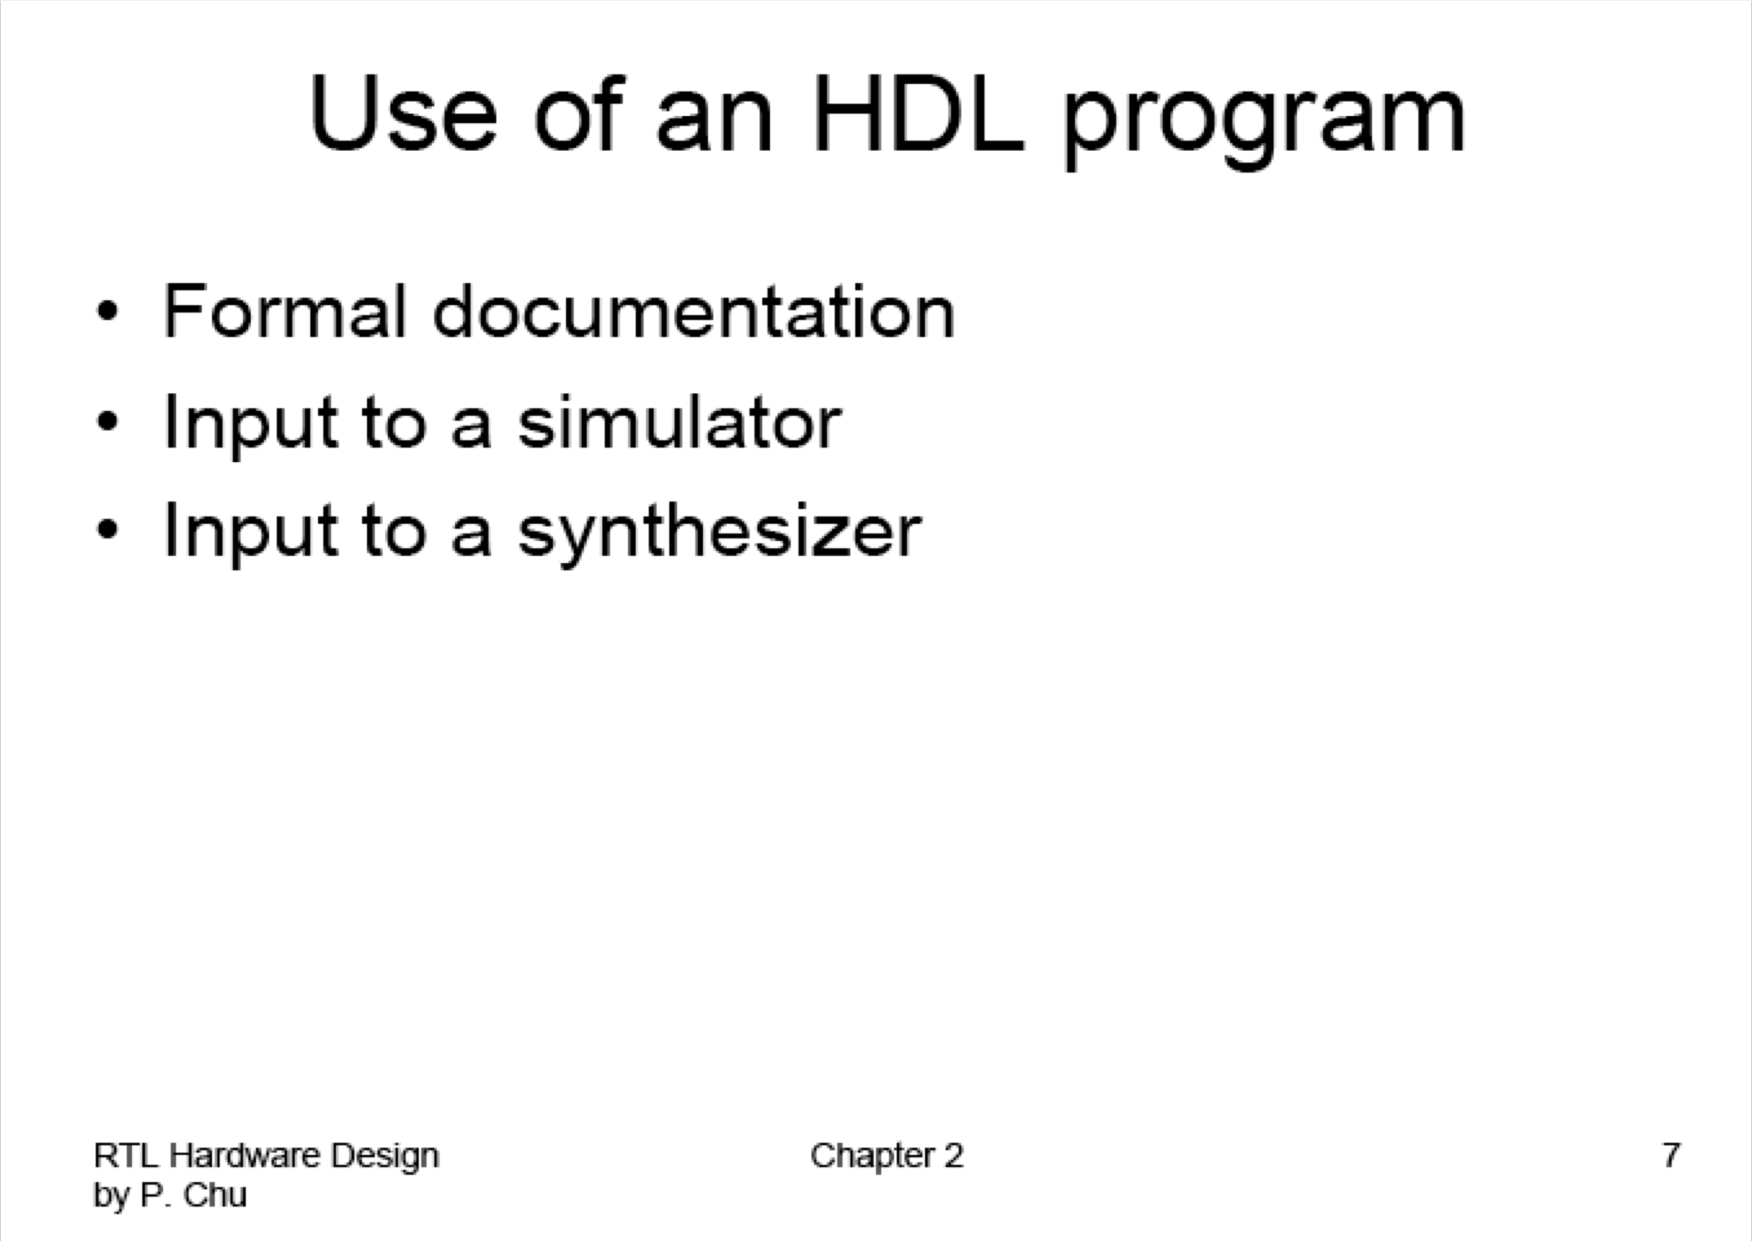

Slide 16
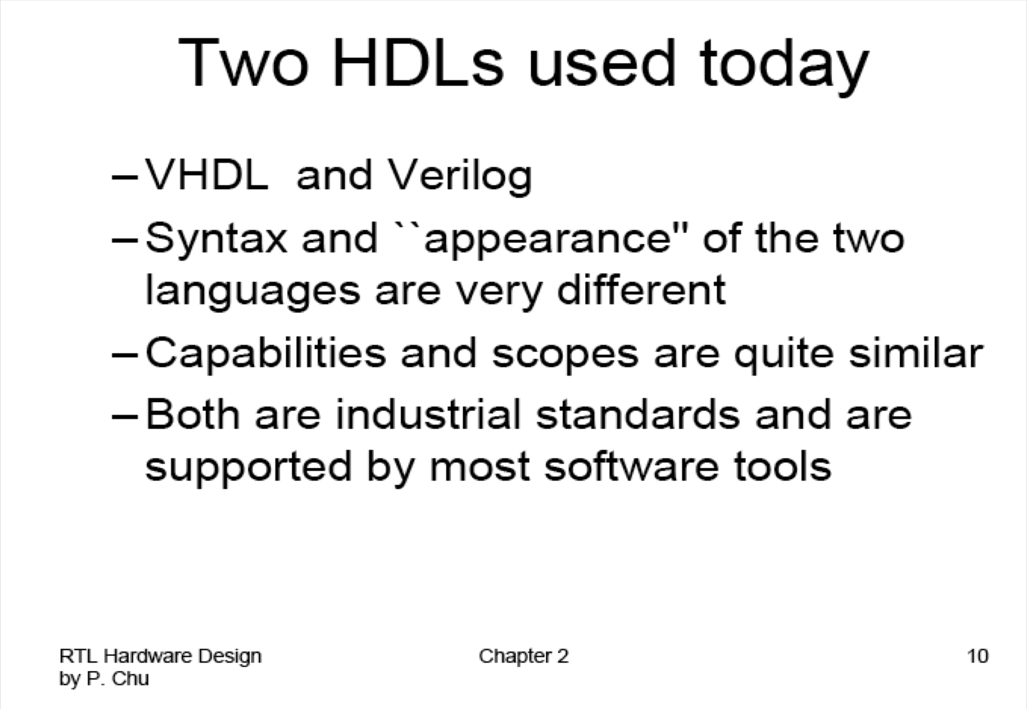

Slide 17
Features of VHDL
Technology/vendor independent
Portable
Reusable

Slide 18
VHDL Fundamentals
ECE 448 – FPGA and ASIC Design with VHDL 6

Slide 19
Naming and Labeling (1)
VHDL is case insensitive
Example:
Names or labels databus Databus DataBus DATABUS
are all equivalent

Slide 20
Naming and Labeling (2)
General rules of thumb (according to VHDL-87)
All names should start with an alphabet character (a-z or A-Z)
Use only alphabet characters (a-z or A-Z) digits (0-9) and underscore (_)
Do not use any punctuation or reserved characters within a name (!, ?, ., &, +, -, etc.)
Do not use two or more consecutive underscore characters ( ) within a name (e.g., Sel A is invalid)
All names and labels in a given entity and architecture must be unique

Slide 21
Valid or invalid?
7segment_display A87372477424
Adder/Subtractor
/reset
And_or_gate AND OR NOT
Kogge-Stone-Adder Ripple&Carry_Adder
My adder

Slide 22
Extended Identifiers
Allowed only in VHDL-93 and higher:
Enclosed in backslashes
May contain spaces and consecutive underscores
May contain punctuation and reserved characters within a name (!, ?, ., &, +, -, etc.)
VHDL keywords allowed
Case sensitive
Examples:
/rdy/ | /My design/ | /!a/
/RDY/ | /my design/ | /-a/

Slide 23
Free Format
VHDL is a “free format” language
No formatting conventions, such as spacing or indentation imposed by VHDL compilers. Space and carriage return treated the same way.
Example:
if (a=b) then
or
if (a=b) then
or
if (a =
b) then
are all equivalent
11

Slide 24
Comments
Comments in VHDL are indicated with a “double dash”, i.e., “--”
Comment indicator can be placed anywhere in the line
Any text that follows in the same line is treated as a comment
Carriage return terminates a comment
No method for commenting a block extending over a couple of lines
Examples:
-- main subcircuit
Data_in <= Data_bus; -- reading data from the input FIFO

Slide 25
Comments
Explain Function of Module to Other Designers
Explanatory, Not Just Restatement of Code
Locate Close to Code Described
Put near executable code, not just in a header

Slide 26
Design Entity
ECE 448 – FPGA and ASIC Design with VHDL 14

Slide 27
Example: NAND Gate
a | b | z
0 | 0 | 1
0 | 1 | 1
1 | 0 | 1
1 | 1 | 0
a
z
b

Slide 28
Example VHDL Code
3 sections to a piece of VHDL code
File extension for a VHDL file is .vhd
Name of the file should be the same as the entity name (nand_gate.vhd) [OpenCores Coding Guidelines]
LIBRARY ieee;
USE ieee.std_logic_1164.all;
LIBRARY DECLARATION
ENTITY nand_gate IS PORT(
a : IN STD_LOGIC; b : IN STD_LOGIC; z : OUT STD_LOGIC);
ENTITY DECLARATION
END nand_gate;
ARCHITECTURE model OF nand_gate IS BEGIN
z <= a NAND b;
END model;
ARCHITECTURE BODY

Slide 29
Tips & Hints
Place each entity in a different file.
The name of each file should be exactly the same as the name of an entity it contains.
These rules are not enforced by all tools
but are worth following in order to increase readability and portability of your designs

Slide 30
Tips & Hints
Place the declaration of each port, signal, constant, and variable
in a separate line
These rules are not enforced by all tools
but are worth following in order to increase readability and portability of your designs

Slide 31
STD_LOGIC Demystified
ECE 448 – FPGA and ASIC Design with VHDL 19

Slide 32
STD_LOGIC
LIBRARY ieee;
USE ieee.std_logic_1164.all;
ENTITY nand_gate IS PORT(
: IN STD_LOGIC;
: IN STD_LOGIC; z : OUT STD_LOGIC);
END nand_gate;
ARCHITECTURE dataflow OF nand_gate IS BEGIN
z <= a NAND b;
END dataflow;
What is STD_LOGIC you ask?

Slide 33
BIT versus STD_LOGIC
BIT type can only have a value of ‘0’ or ‘1’
STD_LOGIC can have nine values
’U’,’X’,‘0’,’1’,’Z’,’W’,’L’,’H’,’-’
Useful mainly for simulation
‘0’,’1’, and ‘Z’ are synthesizable (your codes should contain only these three values)

Slide 34
More on STD_LOGIC Meanings
Do not care.
Can be assigned to outputs for the case of invalid
inputs (may produce significant improvement in resource utilization after synthesis).
Must be used with great caution.
For example in VHDL, the direct comparison
'1’ = '-’
gives FALSE.
'-’
The "std_match" functions defined in the numeric_std package must be used to make this value work
as expected:
Example:
if (std_match(address, "-11---") then ...
elsif (std_match(address, "-01---") then ... else ...
end if;

Slide 35
Modeling Wires and Buses
ECE 448 – FPGA and ASIC Design with VHDL 23

Slide 36
Signals
SIGNAL a : STD_LOGIC;
 | a
 | ¹ wire
SIGNAL b : STD_LOGIC_VECTOR(7 DOWNTO 0);
 | b
 | 8 bus

Slide 37
Standard Logic Vectors
SIGNAL a: STD_LOGIC;
SIGNAL b: STD_LOGIC_VECTOR(3 DOWNTO 0); SIGNAL c: STD_LOGIC_VECTOR(3 DOWNTO 0); SIGNAL d: STD_LOGIC_VECTOR(15 DOWNTO 0); SIGNAL e: STD_LOGIC_VECTOR(8 DOWNTO 0);
……….
a <= ‘1’;
b <= ”0000”; c <= B”0000”;
d <= X”AF67”; e <= O”723”;
-- Binary base assumed by default
-- Binary base explicitly specified
-- Hexadecimal base
-- Octal base

Slide 38
Vectors and Concatenation
SIGNAL SIGNAL | a: b: | STD_LOGIC_VECTOR(3 DOWNTO 0); STD_LOGIC_VECTOR(3 DOWNTO 0);
SIGNAL | c, | d, e: STD_LOGIC_VECTOR(7 DOWNTO | 0);
<= <= | ”0000”; ”1111”;
c <= | a & b; | -- | c | = ”00001111”
d <= | ‘0’ & ”0001111”; | -- | d | <= ”00001111”
e <= | ‘0’ & ‘0’ & ‘0’ & ‘1’ & ‘1’; | ‘0’ | & | ‘1’ & ‘1’ &
 |  | -- | e | <= ”00001111”

Slide 39
VHDL Design Styles
ECE 448 – FPGA and ASIC Design with VHDL 27

Slide 40
VHDL Design Styles
VHDL Design Styles
Testbenches
dataflow
structural
behavioral (sequential)
Concurrent statements
Components and interconnects
Sequential statements
Registers
State machines
Decoders
Subset most suitable for synthesis

Slide 41
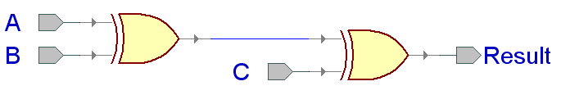
xor3 Example

Slide 42
Entity xor3_gate
LIBRARY ieee;
USE ieee.std_logic_1164.all;
ENTITY xor3_gate IS PORT(
A : IN STD_LOGIC;
B : IN STD_LOGIC; C : IN STD_LOGIC;
Result : OUT STD_LOGIC
);
end xor3_gate;

Slide 43
Dataflow Architecture (xor3_gate)
ARCHITECTURE dataflow OF xor3_gate IS SIGNAL U1_OUT: STD_LOGIC;
BEGIN
U1_OUT <= A XOR B;
Result <= U1_OUT XOR C;
END dataflow;
U1_OUT

Slide 44
Dataflow Description
Describes how data moves through the system and the various processing steps.
Dataflow uses series of concurrent statements to realize logic.
Dataflow is most useful style when series of Boolean equations can represent a logic → used to implement simple combinational logic
Dataflow code also called “concurrent” code
Concurrent statements are evaluated at the same time; thus, the order of these statements doesn’t matter
This is not true for sequential/behavioral statements
This order…
U1_out <= A XOR B;
Result <= U1_out XOR C;
Is the same as this order…
Result <= U1_out XOR C; U1_out <= A XOR B;

Slide 45
Structural Architecture in VHDL 93
xor2.vhd
LIBRARY ieee;
USE ieee.std_logic_1164.all;
ENTITY xor2 IS PORT(
I1 : IN STD_LOGIC;
I2 : IN STD_LOGIC; Y : OUT STD_LOGIC);
END xor2;
ARCHITECTURE dataflow OF xor2 IS BEGIN
Y <= I1 xor I2;
END dataflow;

Slide 46
Structural Architecture in VHDL 93
A B C
xor3_gate
ARCHITECTURE structural OF xor3_gate IS SIGNAL U1_OUT: STD_LOGIC;
Result
BEGIN
U1: entity work.xor2(dataflow)
PORT MAP (I1 => A,
I2 => B, Y => U1
I1 I2
U1_OUT
Y
I1 I2
_OUT);
Y
U2: entity work.xor2(dataflow)
PORT MAP (I1 => U1_OUT,
I2 => C,
Y => Result);
END structural;
PORT NAME
LOCAL WIRE NAME

Slide 47
Behavioral Architecture (xor3 gate)
ARCHITECTURE behavioral OF xor3 IS BEGIN
xor3_behave: PROCESS (A, B, C)
BEGIN
IF ((A XOR B XOR C) = '1') THEN
Result <= '1';
ELSE
Result <= '0';
END IF;
END PROCESS xor3_behave;
END behavioral;

Slide 48
Behavioral Description
It accurately models what happens on the inputs and outputs of the black box (no matter what is inside and how it works).
This style uses PROCESS statements in VHDL.

Slide 49
Arithmetic Operators in VHDL (1)
To use basic arithmetic operations involving std_logic_vectors you need to include the following library packages:
LIBRARY ieee;
USE ieee.std_logic_1164.all;
USE ieee.std_logic_unsigned.all;
or
USE ieee.std_logic_signed.all;

Slide 50
Arithmetic Operators in VHDL (2)
You can use standard +, - operators to perform addition and subtraction:
signal A : STD_LOGIC_VECTOR(3 downto 0); signal B : STD_LOGIC_VECTOR(3 downto 0); signal C : STD_LOGIC_VECTOR(3 downto 0);
……
C <= A + B;

Slide 51
Different ways of performing the same operation
signal count: std_logic_vector(7 downto 0);
You can use:
count <= count + “00000001”;
or
count <= count + 1;
or
count <= count + ‘1’;

Slide 52
Different declarations for the same operator
Declarations in the package ieee.std_logic_unsigned:
function “+” ( L: std_logic_vector;
R:std_logic_vector) return std_logic_vector;
function “+” ( L: std_logic_vector;
R: integer)
return std_logic_vector;
function “+” ( L: std_logic_vector;
R:std_logic)
return std_logic_vector;

Slide 53
Operator overloading
Operator overloading allows different argument types for a given operation (function)
The VHDL tools resolve which of these functions to select based on the types of the inputs
This selection is transparent to the user as long as the function has been defined for
the given argument types.

